Slide 1
Linux

Slide 2
Agenda:
What is Linux? Linux VS Unix
Components of Linux Linux VS Windows
What is GNU GPL?
History of Linux
Use of Linux
Popular variants of Linux
What is Kernel?
What is a Linux Shell?
Architecture of Linux Operating System
User Space and Kernel Space
Advantages of Linux
Features of Linux

Slide 3
What is Linux?

Slide 4
Linux:
Linux is an open-source operating system that is based on the principles of the Unix architecture.
It acts as a bridge between computer hardware and software, enabling various applications to run smoothly while managing system resources such as memory, processing power, and storage.
Linux’s Open Source Nature:
What makes Linux unique is its open-source nature, meaning its source code is freely available for anyone to view, modify, and distribute.
This has fostered a vibrant community of developers who contribute to its growth and customization.

Slide 5
Linux:
Features of Linux being Open-Source:
Transparency.
Customization.
Community Contributions.
Free Distribution.
Adaptable.
Affordable.

Slide 6
Components of Linux

Slide 7
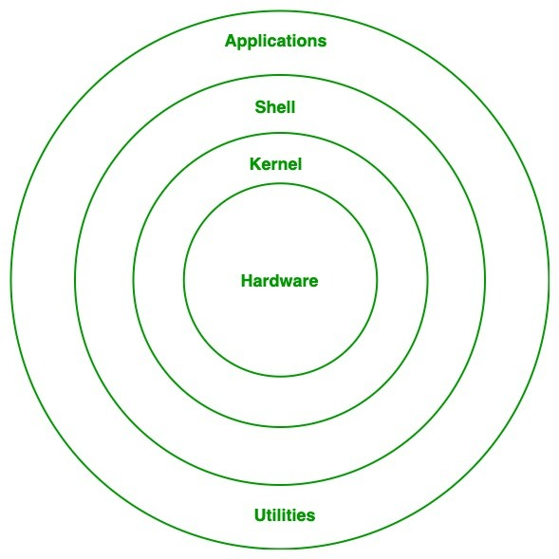
Components of Linux:
Kernel:
The core part of Linux.
It directly interacts with hardware and manages system resources like memory, CPU, and devices.
Handles low-level tasks such as process management and device drivers.

Slide 8
Components of Linux:
System Libraries:
These are special programs that provide functionality to the system and applications.
They enable software and applications to communicate with the kernel without needing detailed hardware knowledge.
Example: GNU C Library (glibc).

Slide 9
Components of Linux:
System Utilities:
Basic tools and commands for managing the system.
Includes utilities for file manipulation, program execution, and user management.
Examples: ls, mv, etc.

Slide 10
Components of Linux:
Shell:
A command-line interpreter that allows users to interact with the Linux system.
Can execute commands, scripts, and manage tasks.
Examples: Bash (Bourne Again Shell), Zsh (Z Shell).

Slide 11
Components of Linux:
Applications:
Various software that runs on top of Linux.
This could include productivity tools, development environments, or server applications.

Slide 12
GNU GPL

Slide 13

GNU GPL:
The GNU General Public License (GPL) is one of the most widely used free software licenses, created by Richard Stallman and the Free Software Foundation (FSF).
It is designed to guarantee users the freedom to use, study, modify, and distribute software.

Slide 14
GNU GPL:
Key Features of GNU GPL:
Freedom to Use.
Access to Source Code.
Permission to Modify.
Freedom to Share.

Slide 15
GNU GPL:
Key Features of GNU GPL:
Copyleft Provision:
The GPL uses a concept called "copyleft," which ensures that any modified or derived software must also be distributed under the same GPL license. This prevents the software from being turned into proprietary products.

Slide 16
History of Linux

Slide 17
History of Linux:
Year | Event | Description
1991 | The Birth of Linux | Linux was created by Linus Torvalds, a Finnish computer science student. Torvalds initially developed it as a personal project to build a free operating system kernel inspired by MINIX (a Unix-like OS). On August 25, 1991, Linus announced his project on the comp.os.minix forum, inviting others to contribute.
1992 | Open-Source Licensing | Linux was released under the GNU General Public License (GPL), making it free and open for modification and redistribution. This fostered global collaboration and development.

Slide 18
History of Linux:
Year | Event | Description
Mid-1990s | Development of Distributions | The first Linux distributions, such as Slackware and Debian, were created to package the kernel with user-friendly tools and applications. These distributions made Linux accessible to a wider audience.
Late 1990s | Expansion to Servers | Linux gained popularity in server environments due to its stability and performance. Major companies like IBM and Oracle began supporting Linux.

Slide 19
History of Linux:
Year | Event | Description
2000s | Growth in Consumer Usage | User-friendly distributions like Ubuntu made Linux more accessible for personal computing. It began to be adopted by hobbyists, developers, and enterprises.
2008 and Beyond | Linux in Mobile and Embedded Systems | Android, based on the Linux kernel, revolutionized the mobile industry and became the world's most-used operating system. Linux also became dominant in embedded systems and IoT devices.

Slide 20
Uses of Linux

Slide 21
Uses of Linux:
Usage | Description
Web Servers | A significant majority of web servers around the world run on Linux. Examples: Popular distributions like CentOS and Ubuntu are commonly used in hosting websites.
Personal Desktops and Laptops | Linux distributions such as Ubuntu, Mint, and Fedora are widely used for personal computing, offering a secure and customizable alternative to proprietary operating systems.
Supercomputers | Nearly all supercomputers in the world use Linux due to its scalability, stability, and performance.

Slide 22
Uses of Linux:
Usage | Description
Embedded Systems | Linux powers a variety of embedded systems, such as routers, TVs, automotive systems, and home automation devices.
Mobile Devices | Android, a widely used mobile operating system, is built on the Linux kernel.
Cloud Computing and Data Center | Linux is the backbone of many cloud services and virtualized environments, including major platforms like AWS, Microsoft Azure, and Google Cloud.

Slide 23
Uses of Linux:
Usage | Description
Programming and Development | Linux provides a robust environment for developers, offering tools and platforms for software development, testing, and deployment.
Educational and Research Environments | Linux is popular in academic and research settings, offering cost-effective and flexible solutions for computer labs and experiments.
Gaming | With the rise of platforms like SteamOS (based on Linux), gaming on Linux has become more accessible and widely adopted.

Slide 24
Popular Variants of Linux

Slide 25
Popular Variants of Linux:
Linux has numerous variants, or distributions, tailored to different user needs. These distributions package the Linux kernel with system utilities, libraries, and applications, providing a complete operating system experience. A few examples are:
Ubuntu Kali Linux
Fedora Linux Mint
Debian Red Hat Enterprise Linux (RHEL)
CentOS OpenSUSE
Arch Linux

Slide 26
What is Kernel?

Slide 27
What is Kernel?
The kernel is the core and foundational component of the Linux operating system.
It acts as a bridge between software applications and the hardware of a computer, ensuring smooth communication and efficient resource management.
Functions of the Kernel:
Resource Management: Manages CPU, memory, and storage, allocating them to different processes as needed.
Hardware Interaction: Acts as an intermediary between hardware devices and software applications.
Process Control: Handles the execution of processes, multitasking, and scheduling.
System Security: Protects data and ensures secure communication within the system.

Slide 28
What is a Linux Shell?

Slide 29
What is a Linux Shell?
A Linux Shell is a command-line interface that acts as an intermediary between the user and the Linux operating system.
It allows users to interact with the system by entering commands, which the shell interprets and passes to the kernel for execution.
Key Features of a Linux Shell:
Command Interpretation.
Scripting Capabilities.
Customizability.

Slide 30
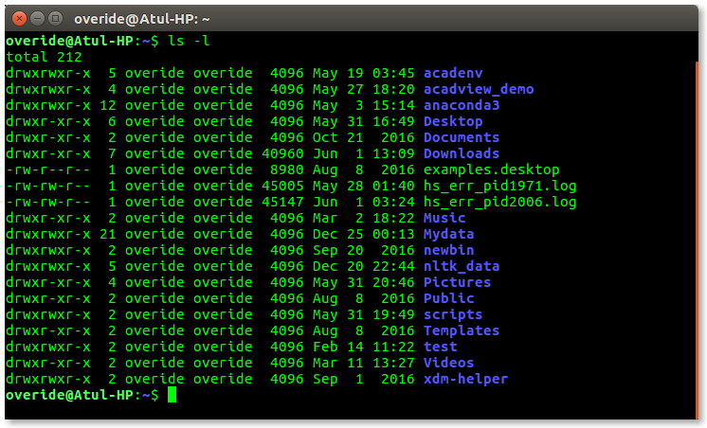
What is a Linux Shell?

Slide 31
Architecture of Linux Operating System

Slide 32
Architecture of Linux Operating System:
Layer | Description
Hardware Layer | This is the physical layer that includes the computer's hardware components, such as the CPU, memory, and storage devices.
Kernel Layer | The core part of Linux, responsible for managing hardware and system resources. Functions: Process management, memory management, device control, and system security.
System Libraries Layer | Contains libraries that provide functionalities for software applications. Example: GNU C Library (glibc) enables interaction with the kernel.

Slide 33
Architecture of Linux Operating System:
Layer | Description
System Utilities Layer | Includes basic tools and programs that allow users to perform system-related operations, such as file management and process control.
User Space Layer | Includes all applications and programs run by users. Provides an environment for user interfaces, graphical user interfaces (GUIs), and shell interactions.

Slide 34
User Space and Kernel Space

Slide 35
User Space and Kernel Space:
Aspect | Kernel Space | User Space
Definition | The memory space where the core of the operating system (kernel) operates. | The memory space where user applications and processes run.
Access Level | Limited access, restricted to ensure system security and stability. | Has privileged access to all hardware resources and system processes.
Operations | Executes high-level tasks such as running applications and user programs. | Performs low-level operations such as device management and system calls.
Memory Protection | Isolated from kernel space to avoid interference with critical functions. | Protected from unauthorized access, ensuring stability and preventing errors.

Slide 36
User Space and Kernel Space:
Aspect | Kernel Space | User Space
Examples | Device drivers, process scheduler, memory manager. | Applications like web browsers, media players, and user-created scripts.
Interaction | Communicates with User Space via system calls (e.g., file operations). | Relies on system calls to interact with Kernel Space (e.g., accessing hardware).
Data Handling | Directly manages hardware-level data such as I/O and memory allocation. | Handles user data and interacts with files or network resources indirectly.
Crash Impact | Errors in Kernel Space can lead to system-wide crashes. | Errors in User Space generally affect only the specific application or process.

Slide 37
Advantages of Linux

Slide 38
Advantages of Linux:
Open Source.
Low Cost.
Stability and Reliability.
Security.
Performance.
Customizability.
Versatility.
Hardware Compatibility.

Slide 39
Features of Linux

Slide 40
Features of Linux:
Open Source. Performance Optimization.
Multi-User Support. Software Repository.
Multi-Tasking. Virtualization.
Portability.
Security.
Stability.
Shell Interface.
Hardware Compatibility.
File System Support.
Modularity

Slide 41
Linux VS Windows

Slide 42
Linux vs Windows:
Aspect | Linux | Windows
Source Code | Open-source: Source code is publicly available and modifiable. | Closed-source: Proprietary code owned by Microsoft.
Cost | Free (most distributions) or minimal costs for enterprise versions. | Generally requires a purchased license for use.
Customizability | Highly customizable: Users can modify the OS and its appearance. | Limited customization options compared to Linux.
User Interface | Offers both GUI and CLI (e.g., GNOME, KDE, terminal). | Primarily GUI, with some CLI options via Command Prompt or Power-Shell.

Slide 43
Linux vs Windows:
Aspect | Linux | Windows
Security | More secure due to user permissions and open-source scrutiny. | Regularly targeted by malware and viruses; requires antivirus software.
Performance | Lightweight; efficient even on older hardware. | Heavier resource usage, especially in newer versions.
File Systems | Supports Ext2/Ext3/Ext4, Btrfs, XFS, etc. | Uses NTFS, FAT32, and exFAT.
Software Compatibility | Supports open-source applications; limited for some proprietary software. | Supports a wide range of proprietary software and applications.

Slide 44
Linux vs Windows:
Aspect | Linux | Windows
Stability | Extremely stable, especially for servers and long-term use. | Stable, but can experience issues with updates or resource-heavy applications.
Community Support | Strong online communities and forums for troubleshooting. | Official support via Microsoft and third-party services.
Learning Curve | Steeper for beginners; requires familiarity with command-line tools. | Easier for beginners, with a user-friendly GUI interface.
Use Cases | Ideal for servers, programming, embedded systems, and advanced users. | Preferred for gaming, business applications, and personal desktops.

Slide 45
Linux VS Unix

Slide 46
Linux vs Unix:
Aspect | Linux | Unix
Source Code | Open-source: Source code is publicly available and modifiable. | Closed-source; proprietary versions exist (e.g., IBM AIX, HP-UX, Solaris).
Cost | Free (most distributions) or minimal costs for enterprise versions. | Expensive; licensing fees apply for proprietary Unix versions.
Customizability | Highly customizable: Users can modify the OS and its appearance. | Limited customizability; source code is often not available for modification.
Origin | Created by Linus Torvalds in 1991. | Developed in the 1970s at AT&T Bell Labs by Ken Thompson, Dennis Ritchie, and others.

Slide 47
Linux vs Unix:
Aspect | Linux | Unix
Security | More secure due to user permissions and open-source scrutiny. | Secure, but often reliant on proprietary updates and patches.
Performance | Lightweight; efficient even on older hardware. | Optimized for stability and performance in large-scale server and enterprise environments.
File Systems | Supports Ext2/Ext3/Ext4, Btrfs, XFS, etc. | Supports fewer file systems, usually those specific to the Unix version.
Compatibility | Runs on a wide variety of hardware, from personal computers to servers and embedded systems. | Primarily designed for servers and high-end systems; hardware-specific.

Slide 48
Linux Q&A
A list of Linux related Q&As.

Slide 49
FAQs of Linux!

Slide 50
FAQs of Linux!
How to Login to Linux Operating System?
How to Implement Linux OS?
To log in to a Linux operating system, boot the system and wait for the login prompt.
If using a graphical user interface (GUI), enter the username and password in the provided fields.
In a command-line interface (CLI) environment, type the username and press Enter, then type the password and press Enter again.
If logging in remotely, use SSH by executing `ssh username@hostname` from another machine.
Implementing Linux involves downloading a distribution such as Ubuntu, Fedora, or Debian and installing it on a machine.
The process includes creating a bootable USB drive using software like Rufus or Balena Etcher, configuring the BIOS/UEFI settings to boot from USB, and following the installation wizard.
Post-installation steps include setting up user accounts, updating packages, and configuring system preferences.

Slide 51
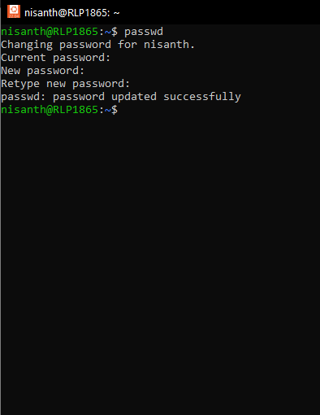

FAQs of Linux!
How to Change Password?
To change the password, use the `passwd` command in the terminal.
Type `passwd`, press Enter, and provide the current password followed by the new password twice.
For changing another user’s password, use `sudo passwd username`.

Slide 52
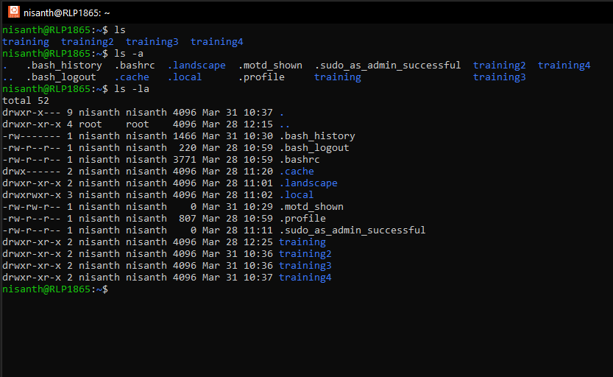
FAQs of Linux!
How We Are Listing Directories and Files?
Files and directories can be listed using the `ls` command.
Running `ls` displays non-hidden files, while `ls -l` provides detailed information.
To include hidden files, use `ls -la`.

Slide 53
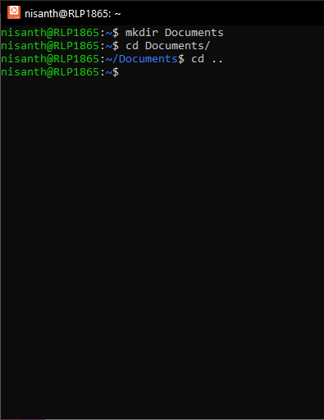
FAQs of Linux!
How to Change Directories?
To navigate directories, use the `cd` command followed by the directory name.
For example, `cd Documents` moves to the Documents directory.
To return to the home directory, use `cd ~`, and to go up one level, use `cd ..`.

Slide 54
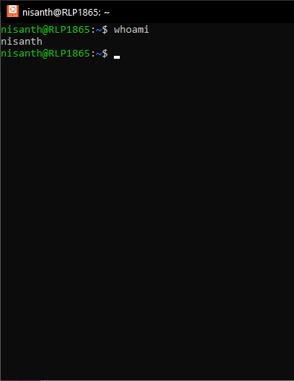
FAQs of Linux!
Who Are You?
To identify the logged-in user, run the `whoami` command. This command prints the username currently in use.

Slide 55
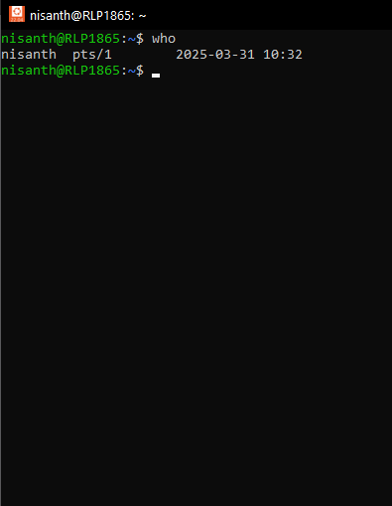
FAQs of Linux!
Who is Logged in?
To see all logged-in users, use the `who` command, which lists active sessions along with login times and originating terminals.

Slide 56
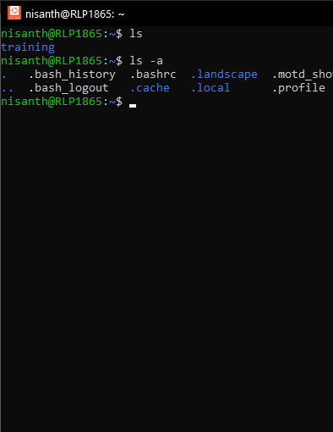
FAQs of Linux!
How to List Hidden or Invisible Files?
Hidden files in Linus environments begin with a dot (`.`) and can be displayed using `ls -la`.

Slide 57
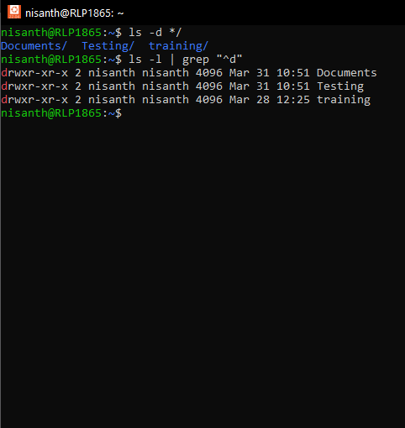
FAQs of Linux!
How to List Directories?
To list only directories, use `ls -d */` or `ls -l | grep "^d"`.

Slide 58
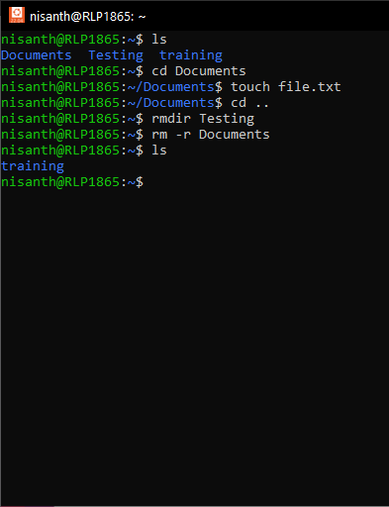
FAQs of Linux!
How to Remove Directories?
To delete empty directories, use `rmdir directory_name`. To remove directories and their contents, use `rm -r directory_name`.

Slide 59
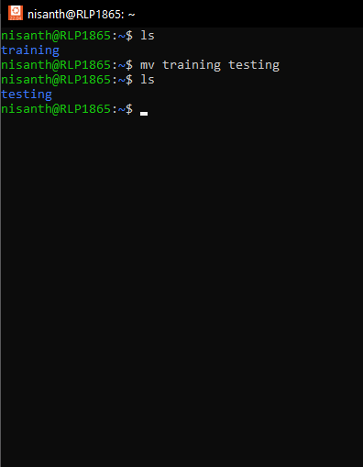
FAQs of Linux!
How to Rename Directories?
Renaming directories is done with the `mv` command: `mv old_directory_name new_directory_name`.

Slide 60
FAQs of Linux!
How to Download Ubuntu OS?
How to Install Ubuntu OS?
To download the Ubuntu operating system, visit the Ubuntu website and choose the "Download Desktop" option, then select the latest LTS version to download the ISO file, which you'll then use to create a bootable USB drive for installation.
Install Ubuntu Desktop
Create a bootable USB, configure boot settings, and follow the installation prompts, setting up partitions and user accounts.

Slide 61
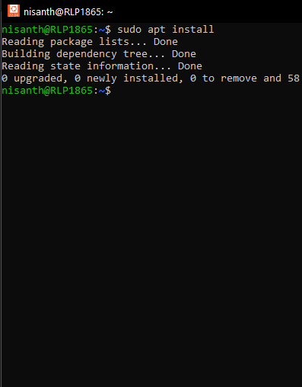
FAQs of Linux!
How to Install Software on Ubuntu?
Use `sudo apt install package_name` for APT-based distributions or `sudo dnf install package_name` for Fedora.

Slide 62
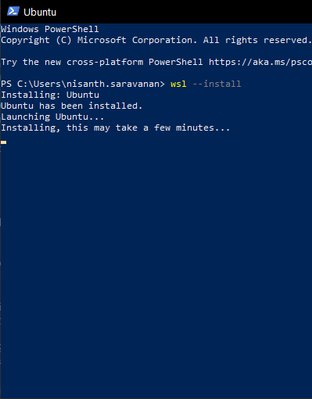
FAQs of Linux!
How to Install Linux on Windows with WSL?
Enable WSL using `wsl --install` in PowerShell. Install a distribution via the Microsoft Store and set up the environment.

Slide 63
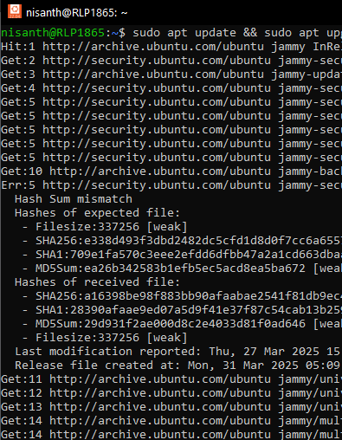
FAQs of Linux!
How to Update and Upgrade Packages Using WSL?
Run `sudo apt update && sudo apt upgrade` to update package lists and install upgrades.

Slide 64
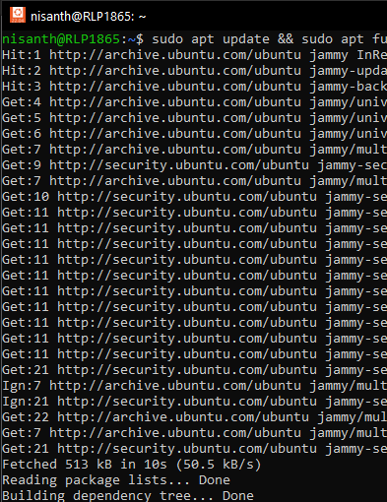
FAQs of Linux!
How to Update Your Linux Distribution?
Use `sudo apt update && sudo apt full-upgrade` for Debian-based systems.

Slide 65
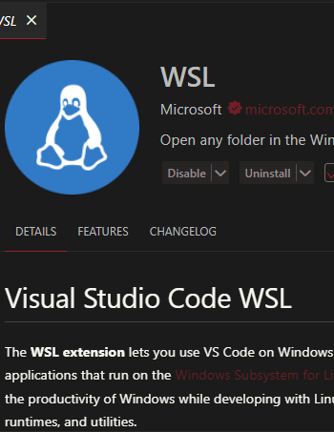
FAQs of Linux!
How to Work with Remote Development in WSL?
Use VS Code with the Remote WSL extension or SSH to connect to remote servers.

Slide 66
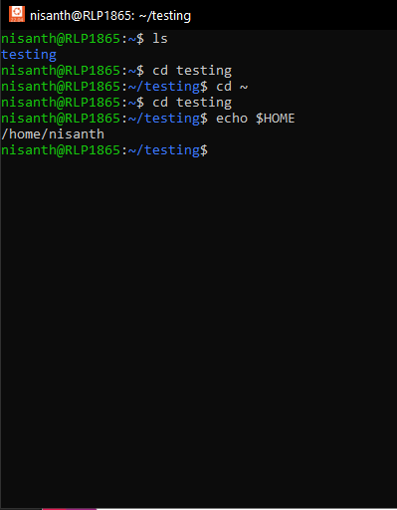
FAQs of Linux!
How to Find the Home Directory?
Use `echo $HOME` or `cd ~`.

Slide 67
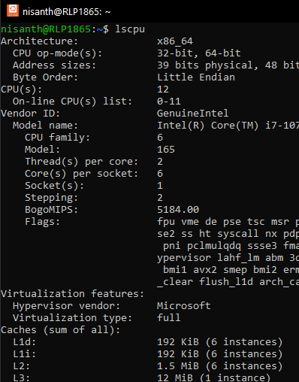
FAQs of Linux!
How to Find CPU Architecture Using lscpu?
Run `lscpu` to display CPU details.

Slide 68
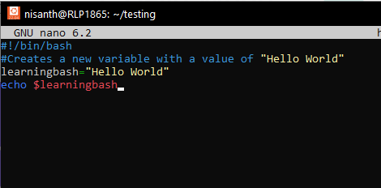
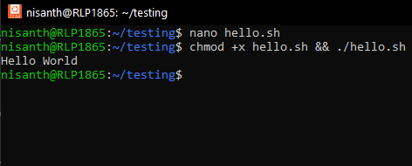
FAQs of Linux!
How to Create and Execute Bash Scripts?
Create a script with `nano script.sh`, add `#!/bin/bash`, write commands, save, and execute using `chmod +x script.sh && ./script.sh`.

Slide 69
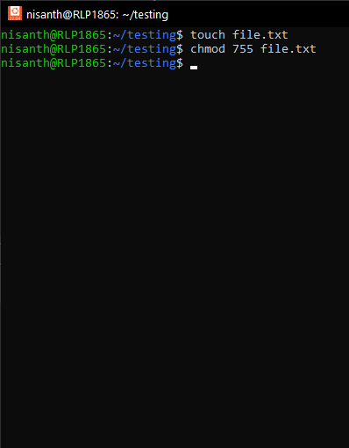
FAQs of Linux!
How to Change Permissions Using Absolute Mode?
To change permissions using absolute mode, use the chmod command followed by a three-digit octal number and the filename or directory.
Example:
chmod 755 filename would give the owner read, write, and execute permissions, while the group and others would have read and execute permissions.

Slide 70
FAQs of Linux!
How to Change Permissions Using Absolute Mode?
Octal Numbers:
Each digit in the octal number represents permissions for a specific user type (owner, group, others).
First digit: Represents permissions for the owner.
Second digit: Represents permissions for the group.
Third digit: Represents permissions for others (or world).

Slide 71
FAQs of Linux!
How to Change Permissions Using Absolute Mode?
Permissions:
Each digit can be a number from 0 to 7, representing:
0: No permission.
1: Execute permission.
2: Write permission.
3: Write and Execute permission.
4: Read permission.
5: Read and Execute permission.
6: Read and Write permission.
7: Read, Write, and Execute permission.

Slide 72
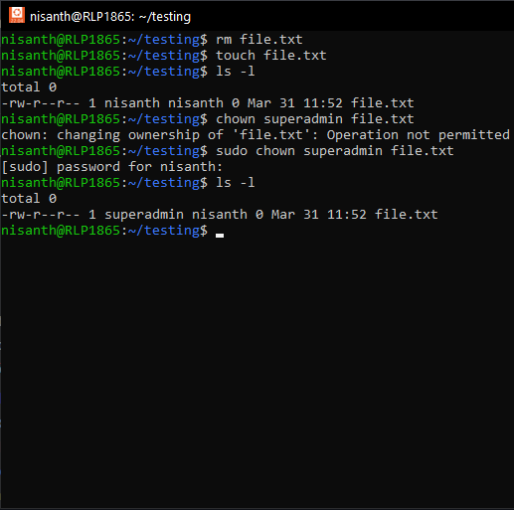
FAQs of Linux!
How to Change Ownership?
Use `chown new_owner filename`.

Slide 73
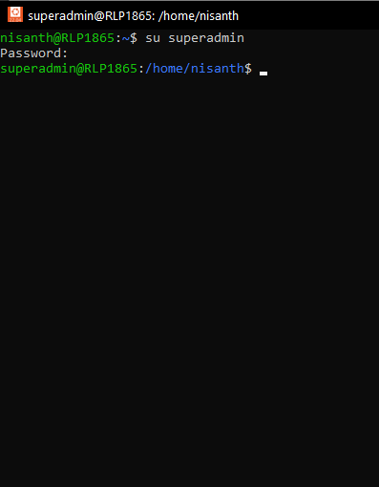
FAQs of Linux!
How to Switch Between Users?
Use `su username` and enter the password.

Slide 74
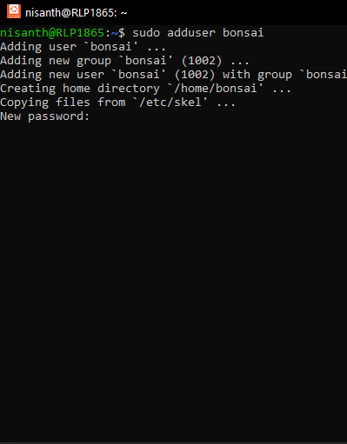
FAQs of Linux!
How to Create Users from the Command Line?
Run `sudo adduser new_username`.

Slide 75
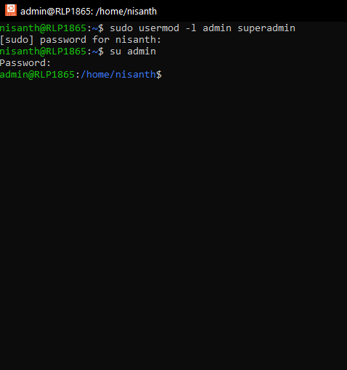
FAQs of Linux!
How to Change a User's Login Name?
Use `sudo usermod -l new_username old_username`.

Slide 76
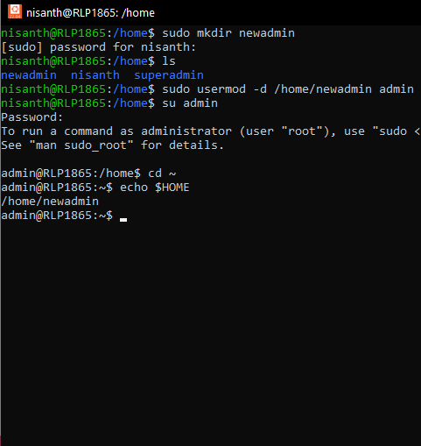
FAQs of Linux!
How to Change a User's Home Directory?
Run `sudo usermod -d /new/home/dir username`.

Slide 77
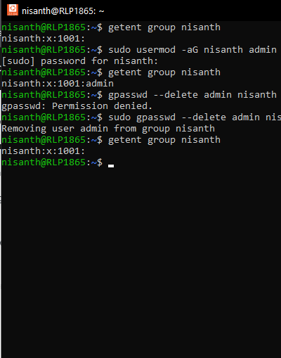
FAQs of Linux!
How to Add a User to a Supplementary Group?
Use `sudo usermod -aG groupname username`.

Slide 78
FAQs of Linux!
How to Remove a User from a Supplementary Group?
Run `sudo gpasswd -d username groupname`.

Slide 79
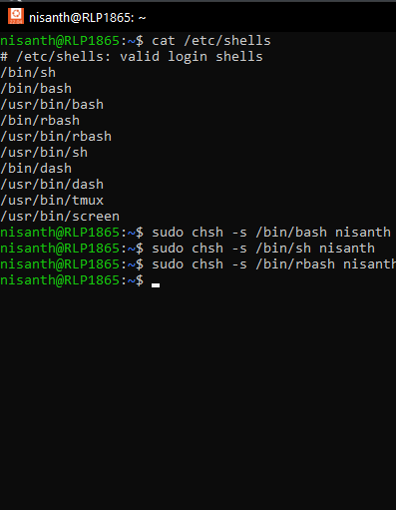
FAQs of Linux!
How to Change a User's Shell?
Use `sudo chsh -s /bin/bash username`.

Slide 80
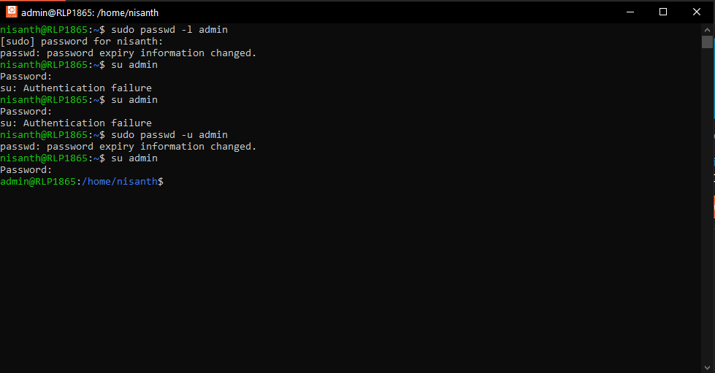
FAQs of Linux!
How to Lock a User's Account?
Use `sudo passwd -l username`.

Slide 81
FAQs of Linux!
How to Unlock a User's Account?
Use `sudo passwd -u username`.

Slide 82
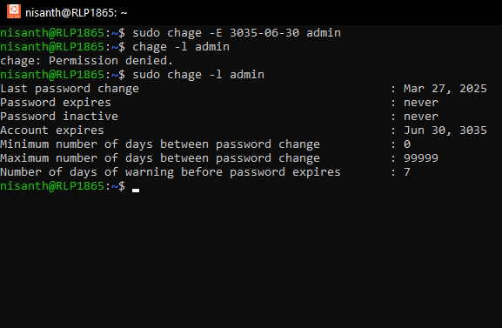
FAQs of Linux!
How to Set an Expiration Date for a User Account?
Use `sudo chage -E YYYY-MM-DD username`.

Slide 83
FAQs of Linux!
How to Unlock a User's Account?
Use `sudo passwd -u username`.

Slide 84
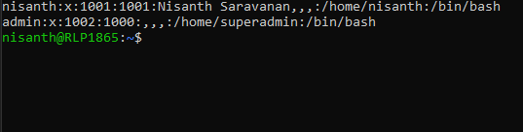
FAQs of Linux!
How to Change a User's User ID (UID)?
Run `sudo usermod -u new_uid username`.

Slide 85
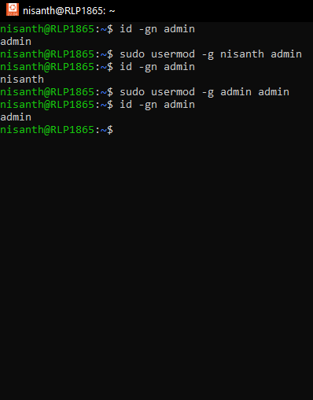
FAQs of Linux!
How to Change a User's Primary Group?
Use `sudo usermod -g groupname username`.

Slide 86
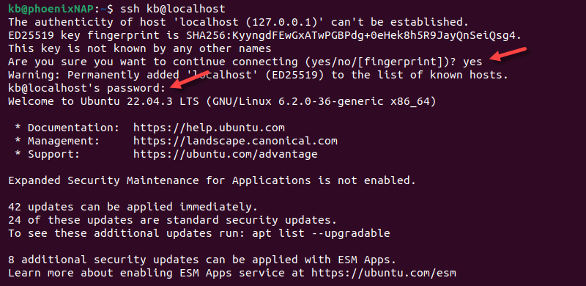
FAQs of Linux!
How to Connect to a Remote Server Using SSH?
Use `ssh username@remote_host`.

Slide 87
Nisanth Saravanan

